Slide 1

NX Bypass in 32bit and 64bit application with Ret2Libc
س. منصور الزياني

Slide 2
agenda
What is NX/DEP
Calling functions in 32-bit applications
Practical Example
Gdb Introduction
Pwntools introduction
Calling functions in 64-bit applications
Practical Example

Slide 3
What is NX/DEP

Slide 4

What is NX/DEP
0xffffffd0 | AAAA | Read/ Write/ Execute
0xffffffd4 | AAAA
0xffffffd8 | AAAA
0xffffffdc | JMP ESP Address
0xffffffdf | Nop
0xffffffe0 | Nop
0xffffffe4 | Nop
0xffffffe8 | Nop
0xffffffec | Nop
0xffffffef | shellcode
Stack

Slide 5

What is NX/DEP
0xffffffd0 | AAAA | Read/ Write/ No Execute
0xffffffd4 | AAAA
0xffffffd8 | AAAA
0xffffffdc | JMP ESP Address
0xffffffdf | Nop
0xffffffe0 | Nop
0xffffffe4 | Nop
0xffffffe8 | Nop
0xffffffec | Nop
0xffffffef | shellcode
Stack

Slide 6
Calling Functions 32-bit

Slide 7
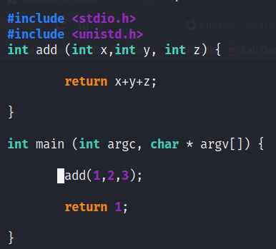
Calling Functions 32-bit

Slide 8
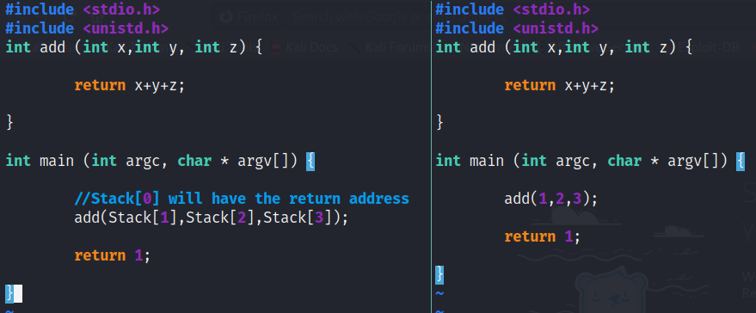
Calling Functions 32-bit

Slide 9
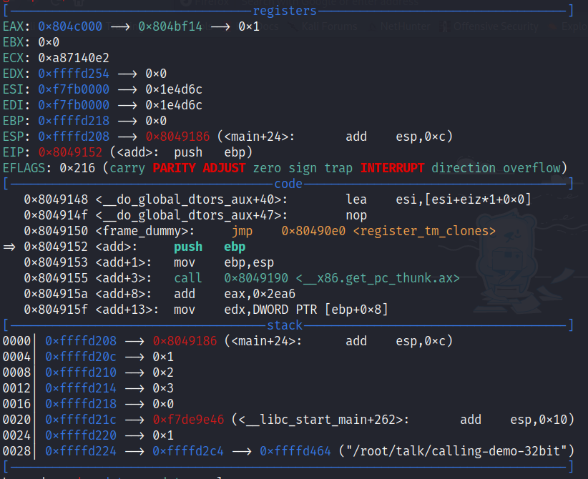
Calling Functions 32-bit

Slide 10
Hacking Time! (32-bit)

Slide 11
64Bit Architecture

Slide 12
64Bit Architecture
32-Bit | 32-Bit | 64-Bit
Register Name | Register Size | Register Name | Register Size
EAX | 32-Bit (4 Bytes) | RAX | 64-Bit (8 Bytes)
EBX |  | RBX
ECX |  | RCX
EDX |  | RDX
EDI |  | RDI
ESI |  | RSI
EBP |  | EBP
ESP |  | RSP
EIP |  | RIP
 |  | R8
 |  | …
 |  | R15

Slide 13
Calling Functions 64-Bit

Slide 14
Calling Functions 64-bit

Slide 15
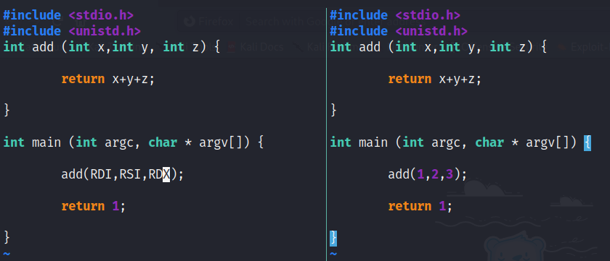
Calling Functions 64-bit

Slide 16
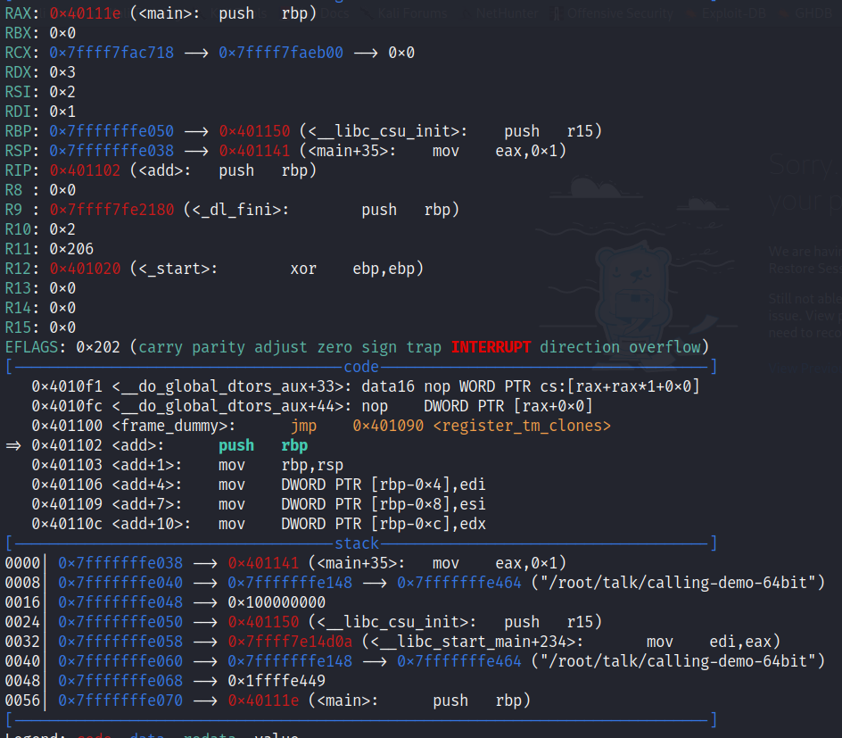
Calling Functions 64-bit

Slide 17
Hacking Time! (64-bit)

